Slide 1
Report for Community Council
25th April – 20th May 202

Slide 2
Numbers:
We have worked with 210 young people
This equated to 420 learning hours
This happened at 26 different activities

Slide 3
Football Coaching with ICT Youth Development
We have been working with ICT Youth Development since last summer,
Young people are learning about ball control, passing skills and shooting,
The improvement in the young people is amazing,
The coaches Craig & Scott enjoy coming to Cromarty each week to deliver football coaching.
The ICT football coaches have been skilling up our young leaders teaching them new skills and games

Slide 4
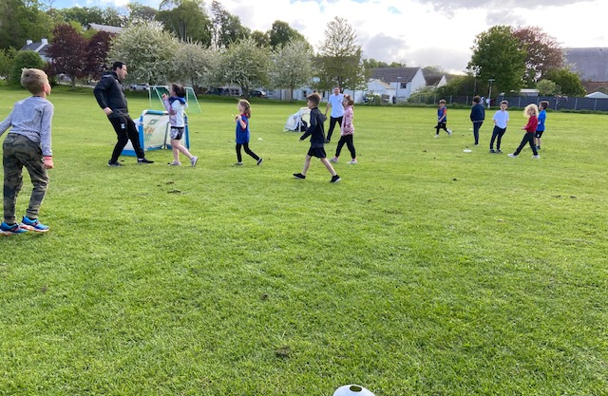
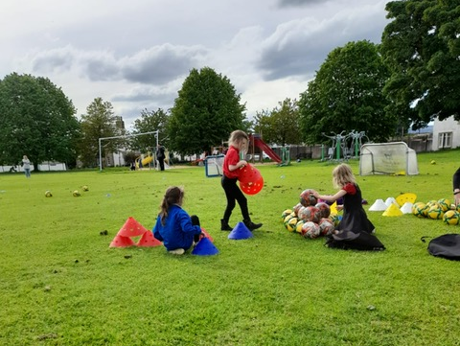
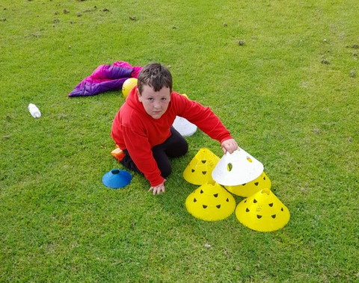
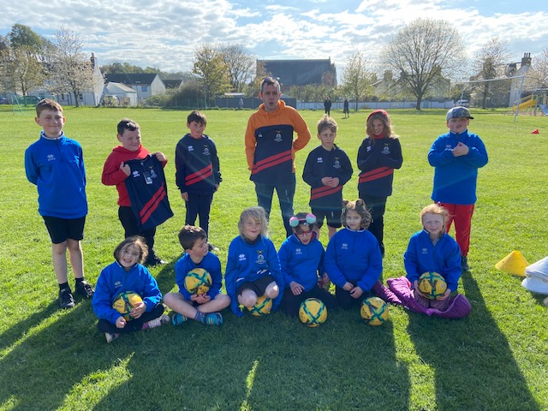

Slide 5
Youth Café
Each week at Junior Youth Café we provide different activities
One week it was Lego week, the young people enjoyed playing with the Lego in the park, they were asked to be as creative as possible.
Other weeks we focus on sports, but the young people decide on the games that we play each week.
Young people created their own code of conduct in agreement with staff

Slide 6
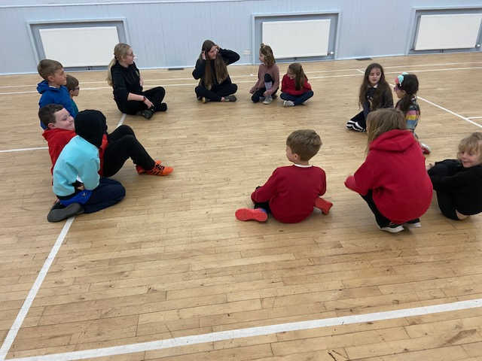
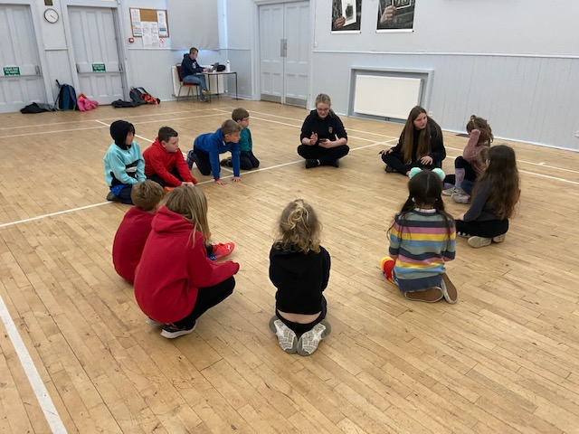
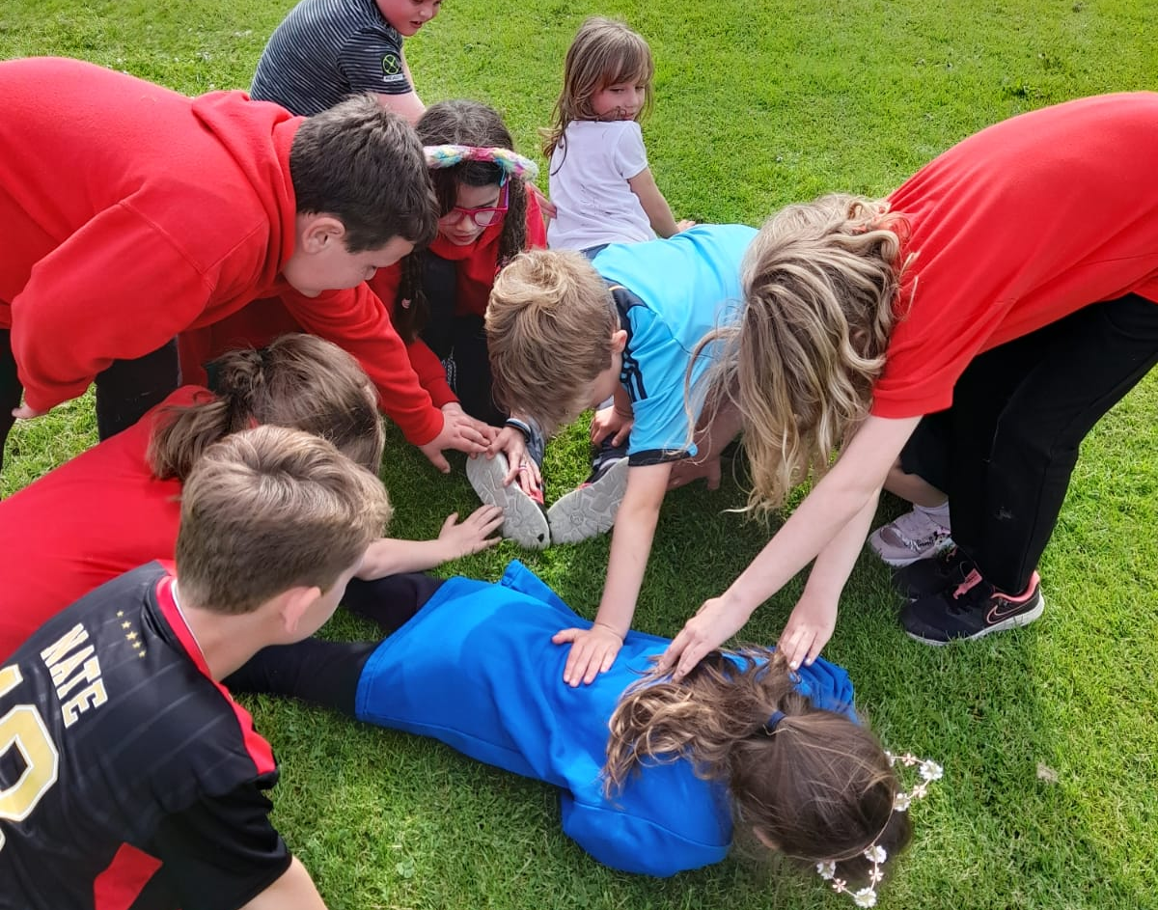

Slide 7
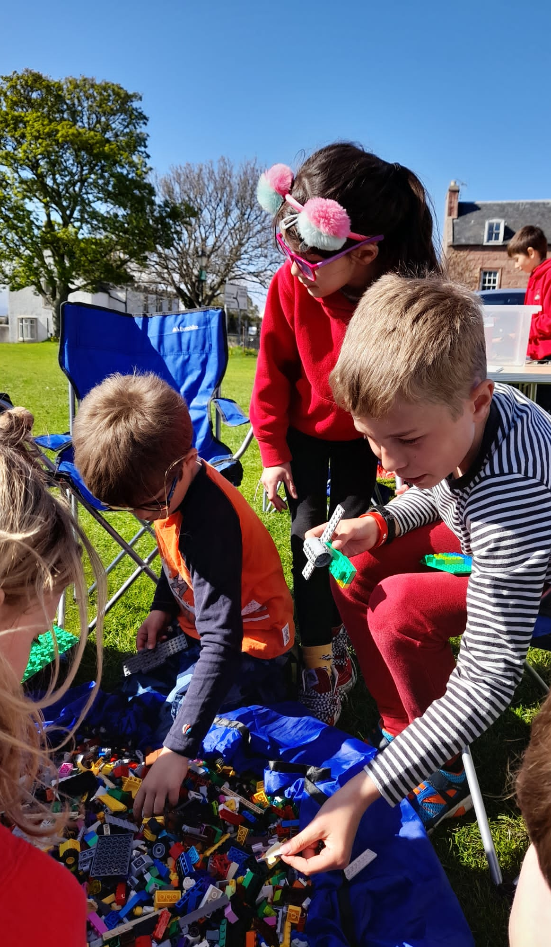
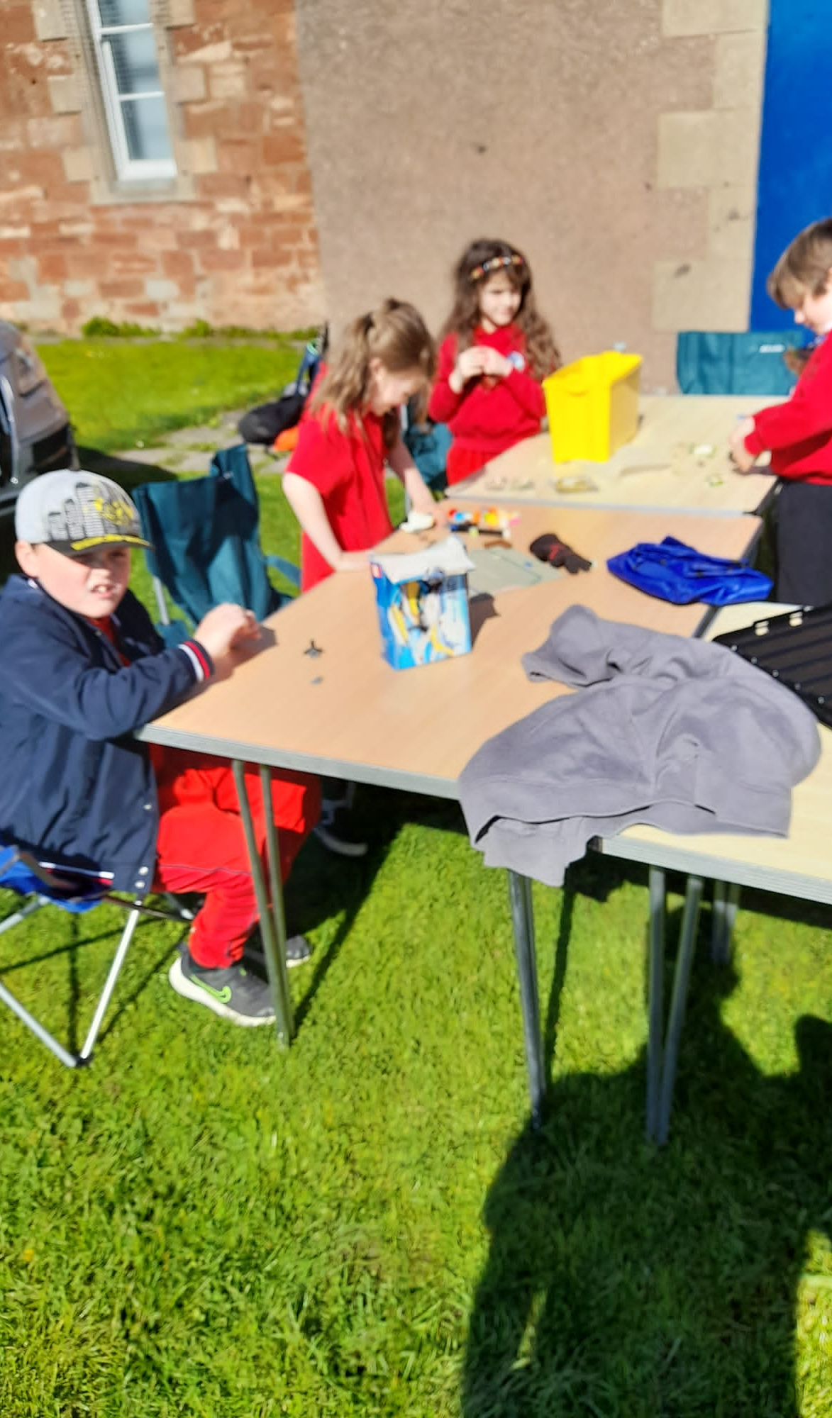
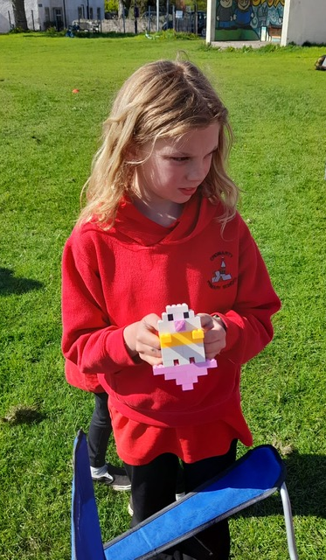

Slide 8
Walk & Talk
Part of Senior Youth Café we often go for a walk around the town,
One of the nights we went round the town doing door to door deliveries with leaflets for the Queens Palatinum Jubilee Community Celebration

Slide 9
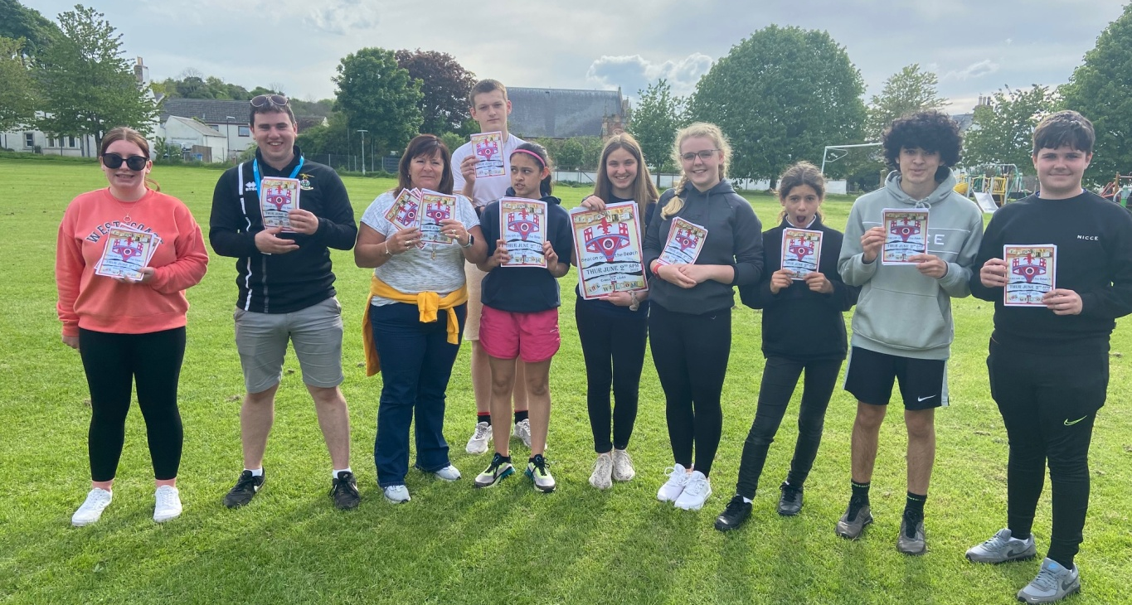
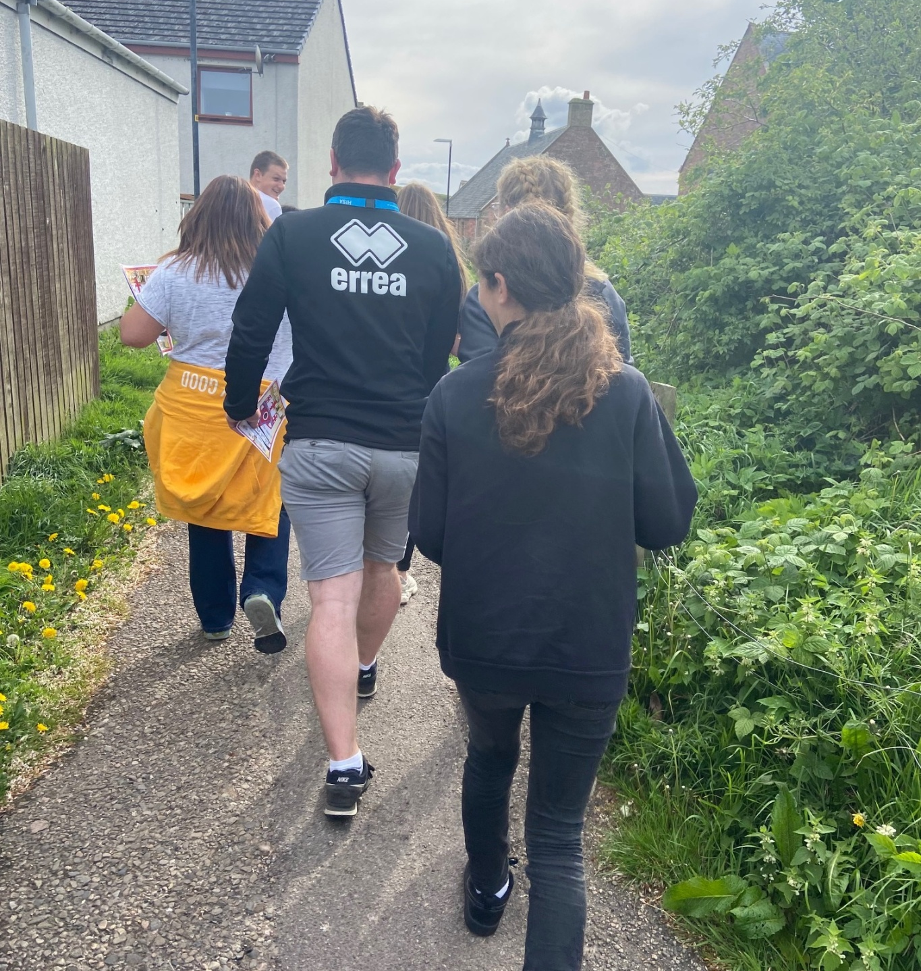
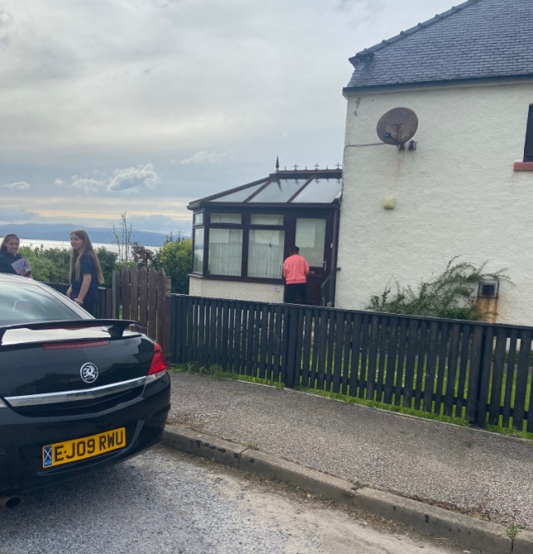
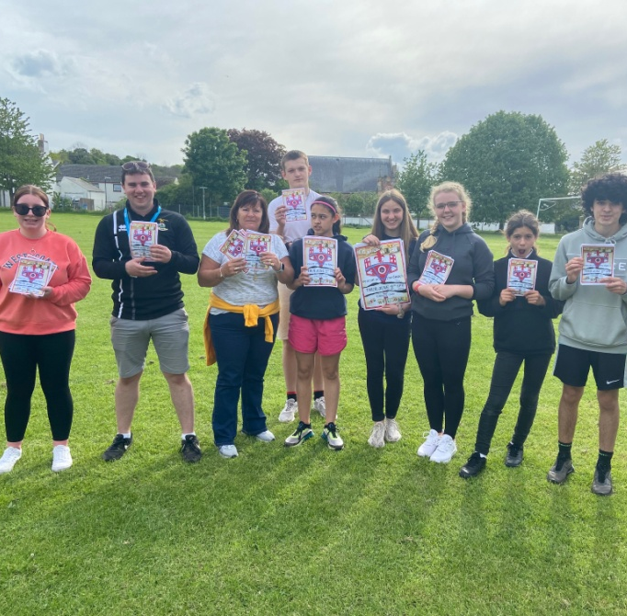

Slide 10
Trip out on the Cycling without Age Trikes
For one of the senior youth café session young people asked to go out on the trikes,
John and I took the young people around the town on the trikes,
The young people enjoyed being outside again and the night we went out on the trikes was lovely weather.

Slide 11
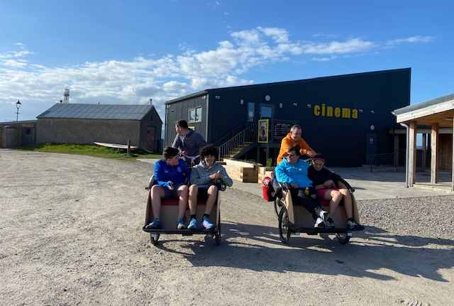
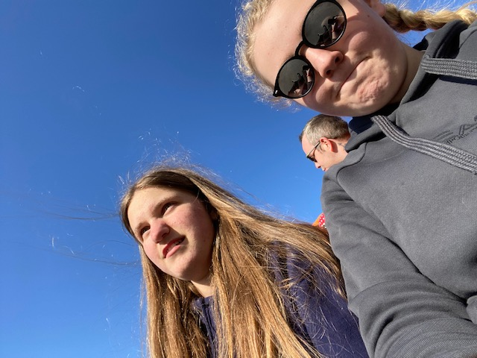
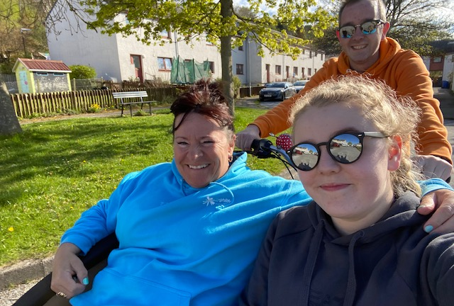

Slide 12
Trip to Edinburgh
At the start of the month, Wanda, Ethan and myself attended The Citadel Youth Project down in Edinburgh to be part of their launch of their Old’s Cool Digital Intergenerational Practice Toolkit.
We had a lovely time meeting all their young and older people down in Edinburgh,
This was on the back of Ethan being successful on a funding application from the Big Ideas fund from the Audrey Milan Trust
This was the first trip out of area since before COVID, and this was the fist time Ethan had ever been to Edinburgh,
We took Ethan to see some of the sights of Edinburgh.

Slide 13
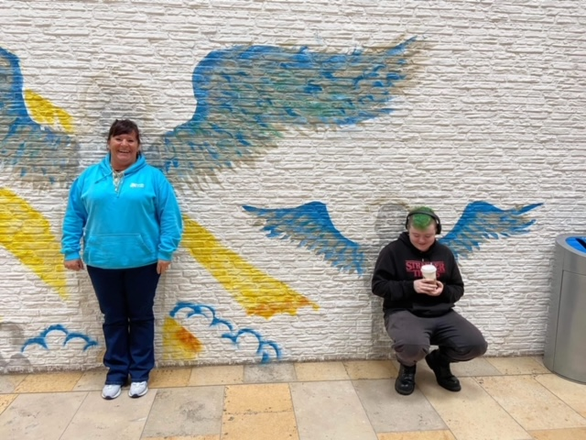
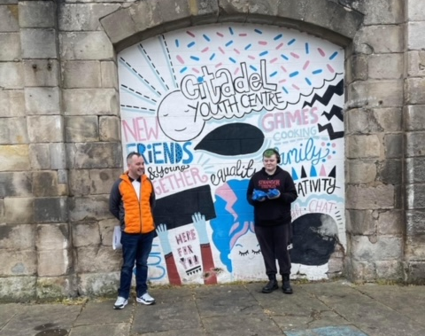
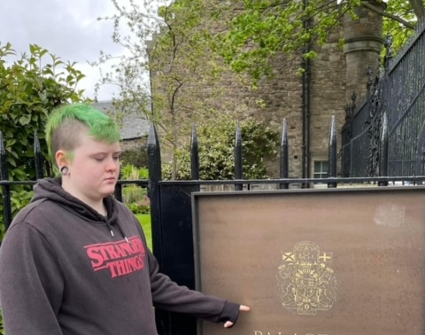

Slide 14
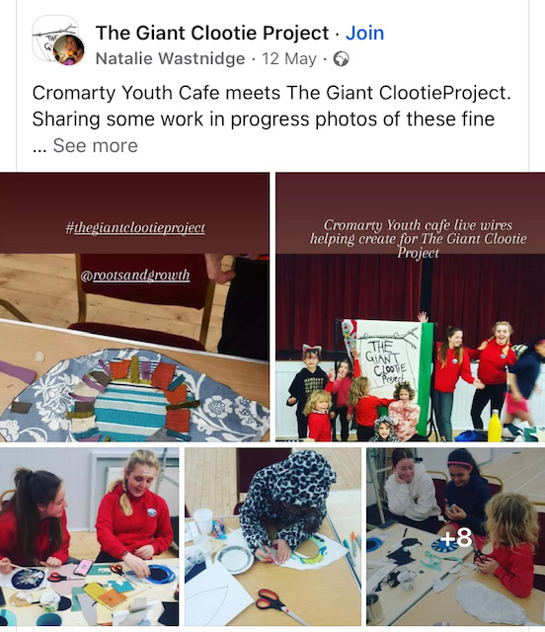
The Giant Clootie Project with The Roots & Growth Project

Slide 15
What is the Giant Clootie Project
Cloth tells a story. Just as the cloots hanging on the branches at the Clootie well are believed to help recovery from illness, the cloots that you create will be offerings and suggestions as to how we can build and create a better future.
The Giant Clootie Project is a chance to be part of a large community art piece that is made up of many individual parts that depict your ideas about renewal, regeneration, reuse, rebirth and the climate emergency.
The Giant Clootie will become a record of our thoughts and feelings at this moment in time.
Now more than ever, we have the opportunity to emerge again, gather and create as a community

Slide 16
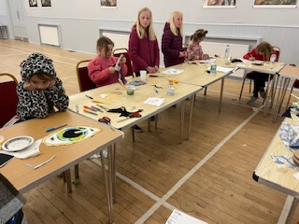
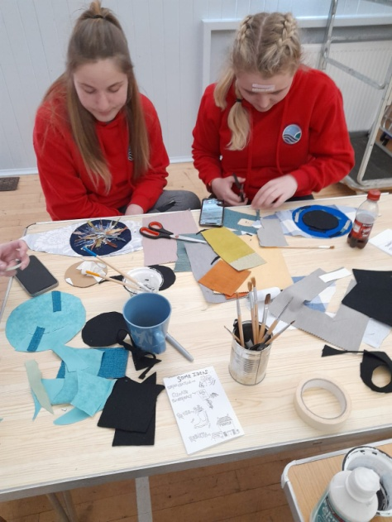
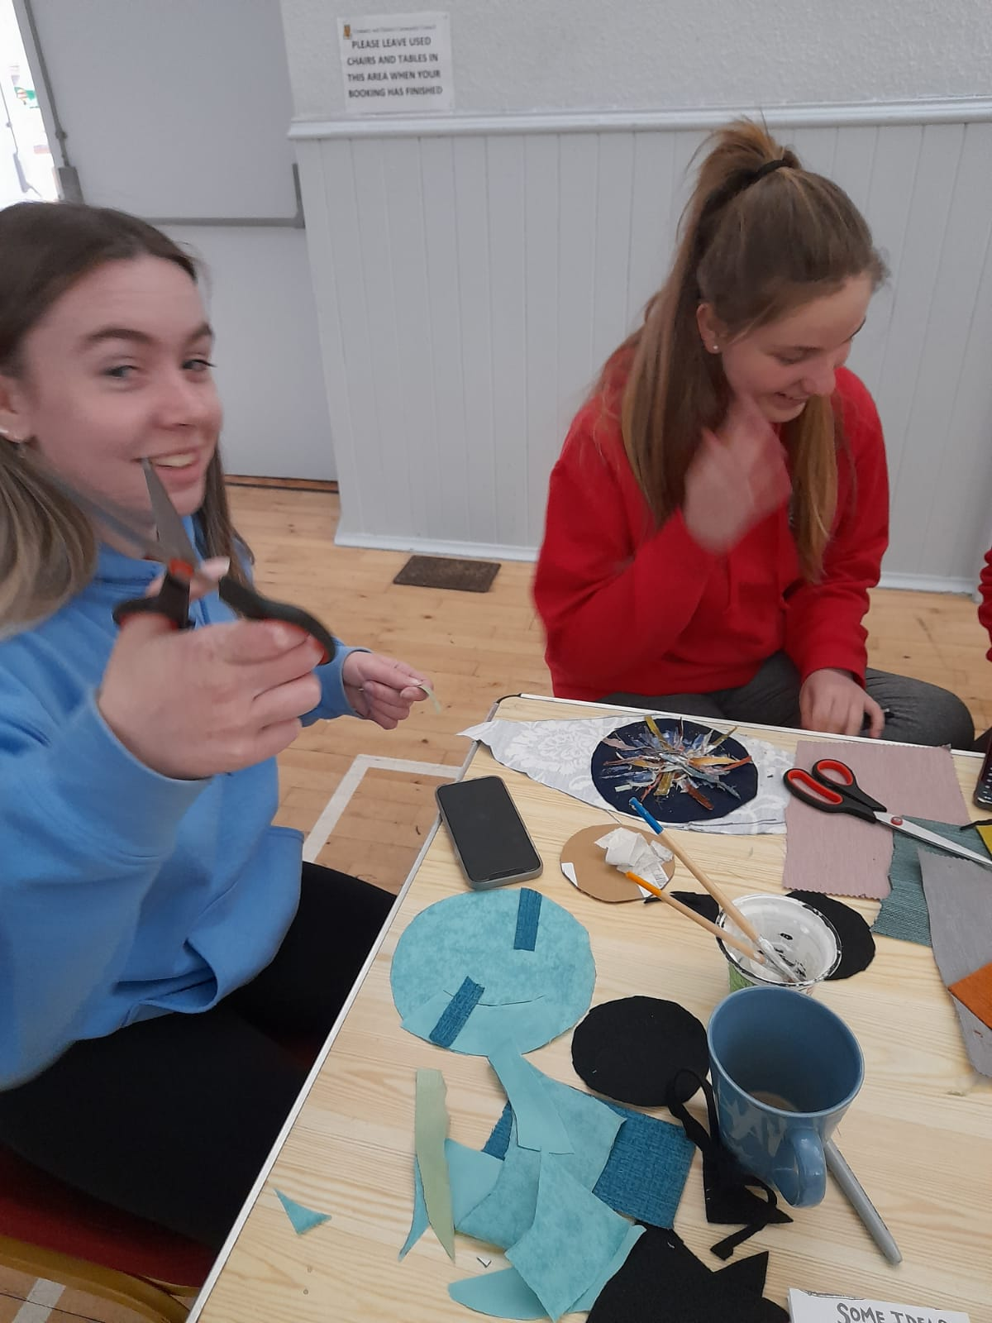
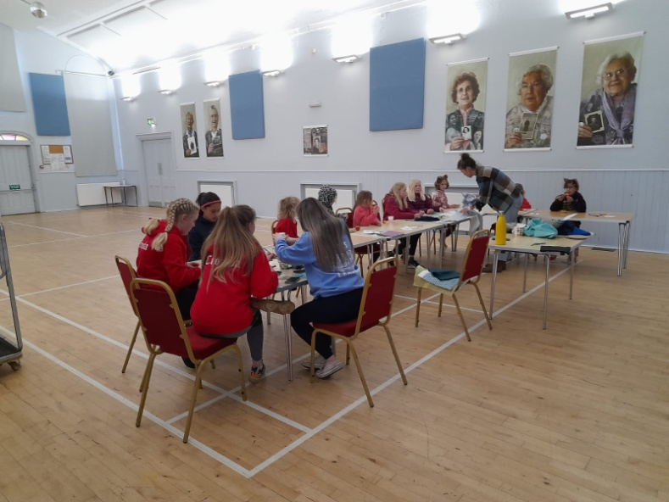
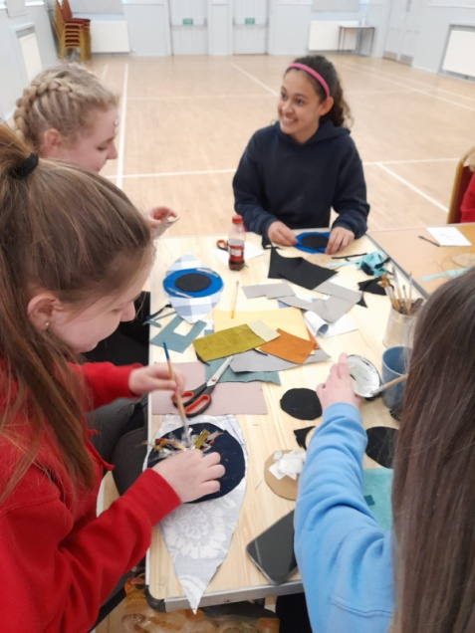

Slide 17
Multi-Sports
Every Monday night, this is led by Young leaders
The young leaders are working toward Their Choose Lead Level 4 with High Life Highland
Young leaders plan , deliver and then review the session
The plan is always delivered around what young people want,
Each week young people are playing new games and are working on different skills, such as team work, throwing and catching, & communication skills

Slide 18
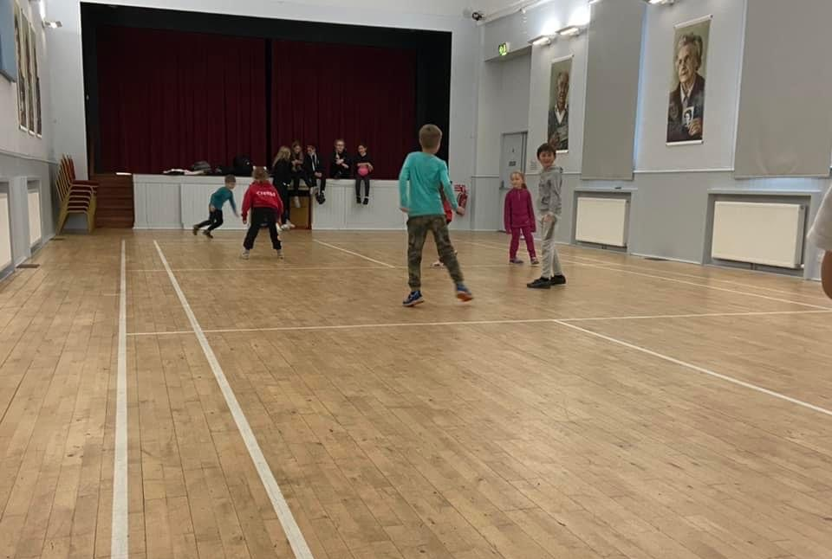
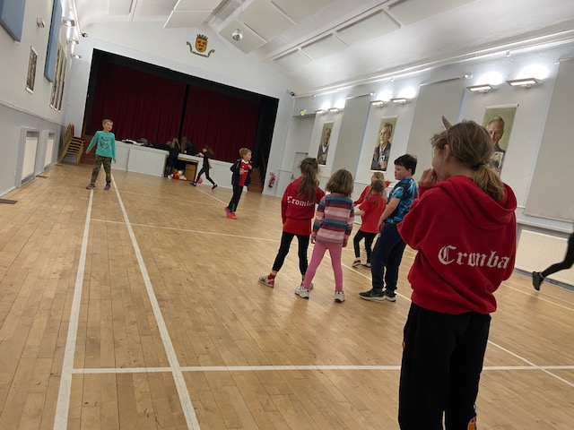
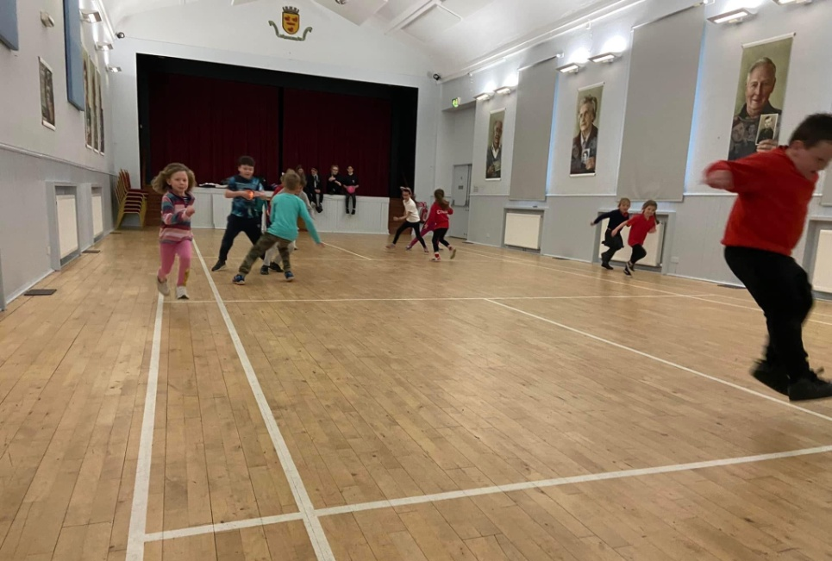

Slide 19
Rowing
Youth Rowers from Cromarty were on the crest of a wave after a fantastic showing at a Broughty Ferry regatta.
The club returned with U19s Girls Gold; U19s Girls Silver; U19s Boys Bronze and an Open Mixed Silver.
This was great day out and such a great feeling of seeing the young people do so well, after all their training and hard work.

Slide 20
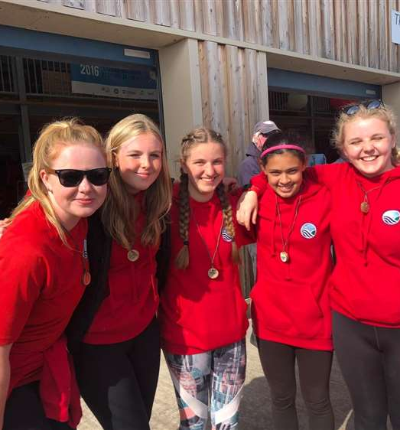
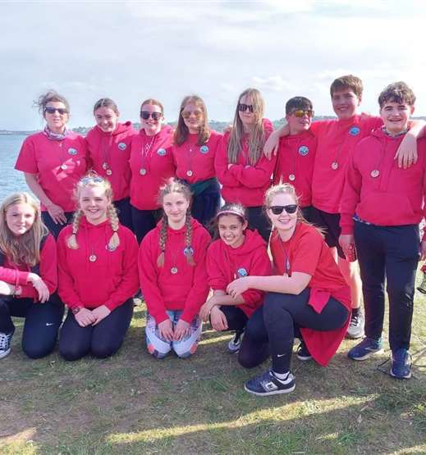

Slide 21
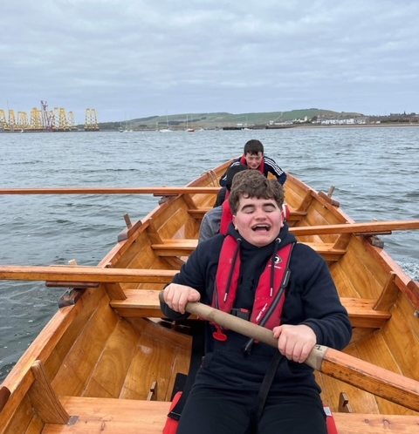
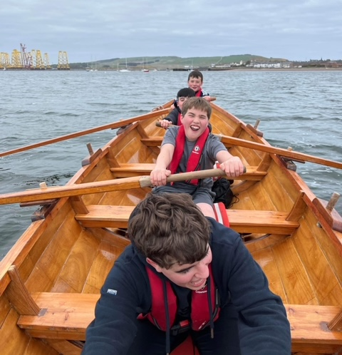

Slide 22
Young Scot Award
Freya our Finalist for Young Scot Awards Sunday Mail Young Scot Awards
Freya has over 700 hours Volunteering in her Saltire Awards and has supported a huge range of projects , one of Freya's projects was to raise funds to ship clothes to refugees in need , she achieved ghis through a sponsored silence as well as hosting a 24 hour Ceilidh Her efforts raised more than £3000 for refugees
Freya your work has been invaluable a nomination i was delighted to do 👌😎
https://nam12.safelinks.protection.outlook.com/?url=https%3A%2F%2Fwww.inverness-courier.co.uk%2Fnews%2Ftotal-surprise-as-highland-teen-is-shortlisted-for-young-sco-273340%2F&amp;data=05%7C01%7C%7Cb73c8f24434d45f35c7408da3e8c1f32%7C84df9e7fe9f640afb435aaaaaaaaaaaa%7C1%7C0%7C637891068781397730%7CUnknown%7CTWFpbGZsb3d8eyJWIjoiMC4wLjAwMDAiLCJQIjoiV2luMzIiLCJBTiI6Ik1haWwiLCJXVCI6Mn0%3D%7C3000%7C%7C%7C&amp;sdata=GuLHgAnaMTwA%2Fo3tCDWeIGPAkfCeuRELIzT7vwnqBSs%3D&amp;reserved=0

Slide 23
Saltire Awards & HLH Leadership
Biggest Well done to Tilly Grist, Teagan Young & Ethan Paterson for gaining their 500 hour Saltire Award for Volunteering.
The Saltire Awards are the Scottish Government's way of celebrating, recognising and rewarding the commitment, contribution and achievements of our young volunteers in Scotland.
Well done to Tilly also for gaining her gold HLH Leadership Hoodie for 500 hours of leadership
Huge thank you to Our Lord Lieutenant Joanie Whiteford for presenting their certificates

Slide 24
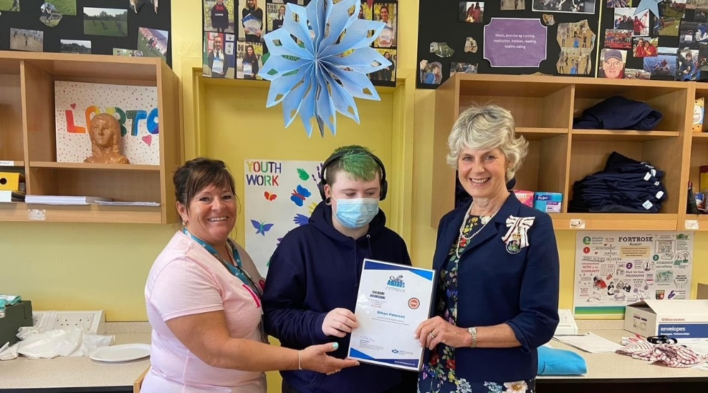
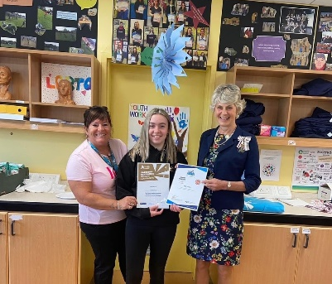
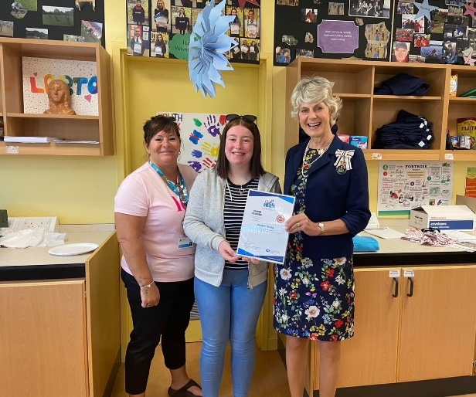

Slide 25
#Foodtherapy
At every activity we offer food whether it is a 1-1 or group session there is food provided at each activity.
We are all to aware of the Food or Fuel poverty a number of our families are in.
Young people are consulted as to what they would like to make / eat at each activity.

Slide 26
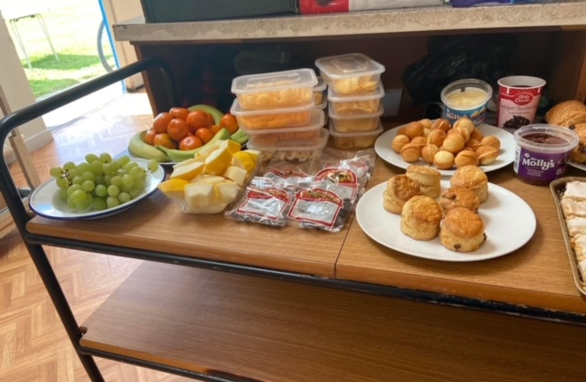
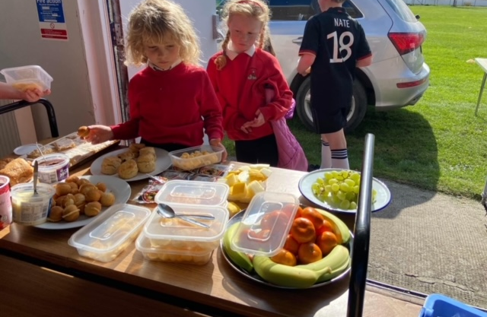
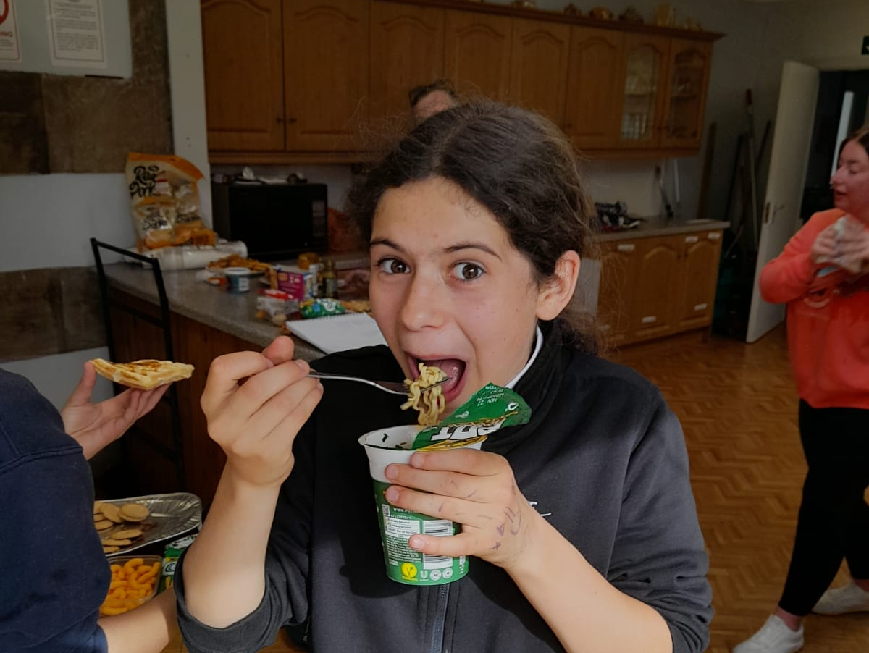
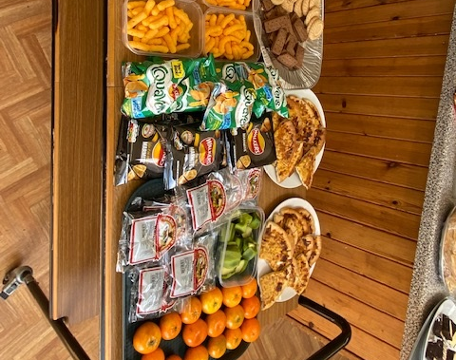
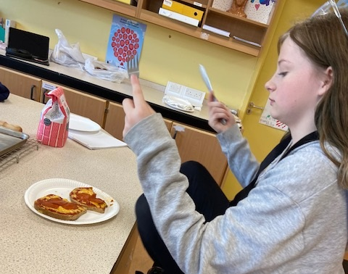

Slide 27
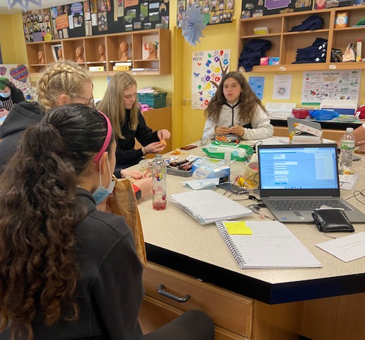
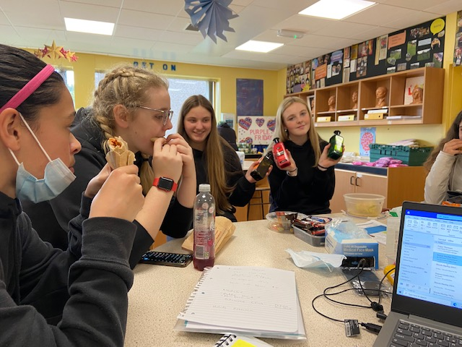
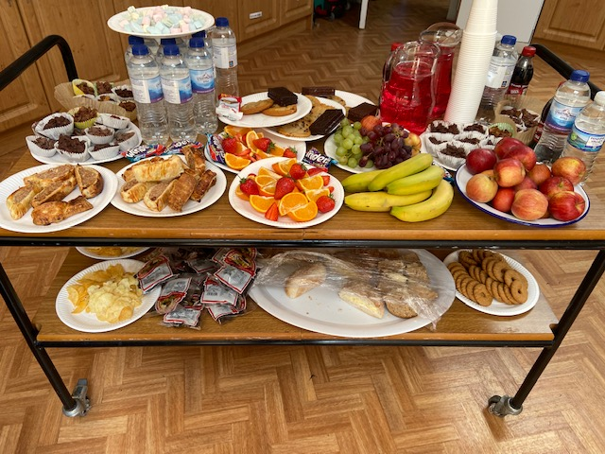

Slide 28
1-1s
Emotional Checks in
Cookwell / Bakewell
Building confidence
Supporting YP to take part in driving theory test
Supporting YP to take part in school subjects
Listening to young peoples fears about leaving school and transitioning in the world of work, a number of young people are feeling anxious about leaving school as school in there safe zone and now they are stepping out of it.
Wanda and myself have been supporting a young lad who has moved to the area from the Ukraine.

Slide 29
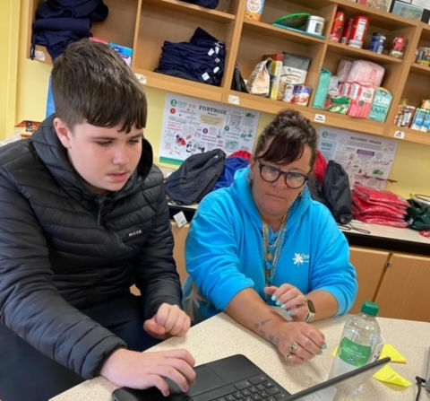
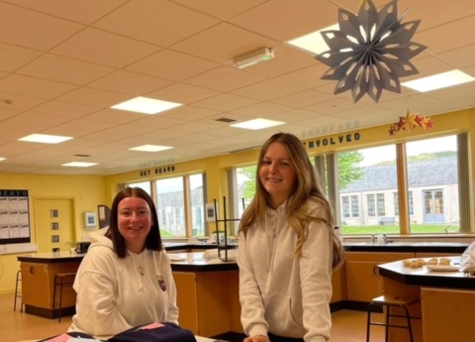
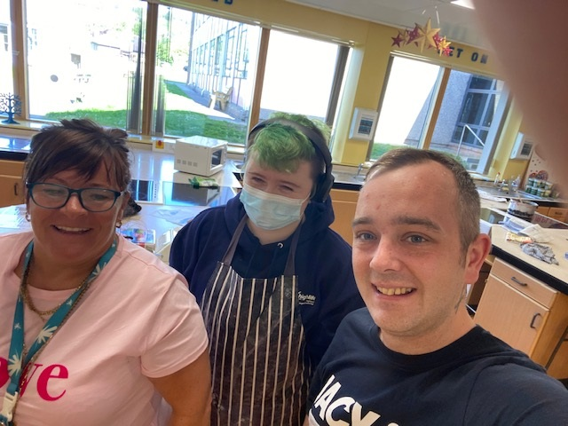

Slide 30
Thank You for Reading

